Slide 1
Brainspotting:
A Neuroexperiental Model for Healing
“Where you look affects how you feel”
Notes:
1

Slide 2
13,001 Therapists trained in Brainspotting
125 BSP Trainers Internationally
Argentina, Armenia, Australia, Austria, Azerbaijan, Belgium, Brazil, Canada, Chile, China, Costa Rica, Croatia, Ecuador, El Salvador, France, Latvia, Germany, Greece, Hungary, India, Indonesia, Israel, Italy, Japan, Madagascar, Mexico, The Netherlands, New Zealand, Norway, Panama, Paraguay, Philippines, Poland, Portugal, Romania, Russia, Samoa, Senegal, Slovenia, Serbia, South Africa, South Korea, Spain, Sweden, Switzerland, Taiwan, Thailand, Turkey, U.S., Ukraine, UK
Notes:
Argentina, Belgium, Brazil, Ecuador,

Slide 3
New Research in Brainspotting
A paradigm shift in trauma treatment: converging evidence for a novel adaptation of EMDR
Talbot, de la Salle and Jaworska
The Canadian Journal of Psychiatry, 2022
The preliminary efficacy and clinical applicability of Brainspotting among Filipino women with severe posttraumatic stress disorder
Palsimon, Jr.
Archives of Psychiatry and Psychotherapy, 2022
Psychotherapeutic techniques for distressing memories: A comparative study between EMDR, Brainspotting and Body scan Meditation
D’Antoni, Matiz, Fabbro and Crescentini
International Journal of Environmental Research of Public Health, 2022

Slide 4
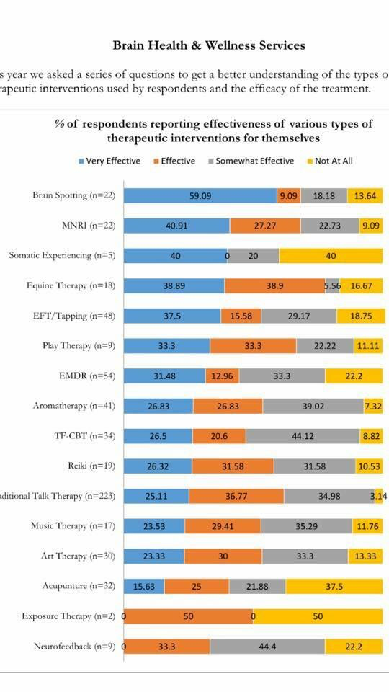
Brainspotting found to be the most effective mode of therapy used in Newtown-Sandy Hook, Connecticut for survivors of the 12/14 school shooting

Slide 5
Brainspotting – the efficacy of a new therapy approach for the treatment of Post Traumatic Stress Disorder in comparison to Eye Movement Desensitization and Reprocessing
by Hildebrand, Grand and Stemmler
Mediterranean Journal of Clinical Psychology MJCP
Vol 5, No 1 (2017)

Slide 6
Brainspotting: Sustained attention, spinothalamic tracts, thalamocortical processing, and the healing of adaptive orientation truncated by traumatic experience
by Frank Corrigan, David Grand and Rajiv Raju
Published in journal Medical Hypotheses
(May 2015)
Notes:
Brainspotting: A Neurobiological Hypothesis by Frank Corrigan and David Grand to be published in journal Medical Hypotheses

Slide 7
Brainspotting: A Neurobiological Hypothesis by Frank Corrigan and David Grand published in journal Medical Hypotheses
(May 2013)
Notes:
Brainspotting: A Neurobiological Hypothesis by Frank Corrigan and David Grand to be published in journal Medical Hypotheses

Slide 8
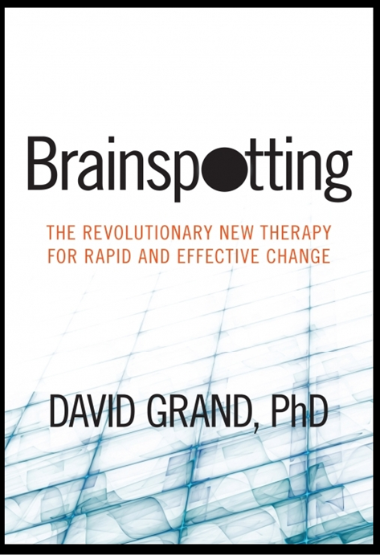
Released by
Sounds True
2013
Also available in digital download and audiobook

Slide 9
For information go to:
Brainspotting.com
Notes:
Brainspotting.pro

Slide 10
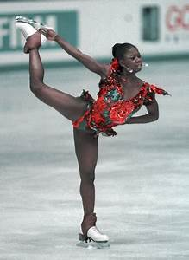
The discovery of Brainspotting occurred in 2003 with a 16 year old figure skater who couldn’t master the triple loop. I targeted the moment her jump went awry.
While she tracked my finger crossing her visual field, her eyes wobbled and froze. He instinctively held her gaze at that point.
Notes:
10
The Discovery of Brainspotting

Slide 11
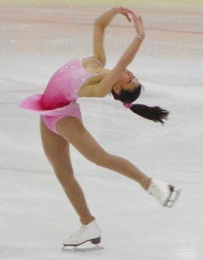
A torrent of trauma material poured out
for the next ten minutes.
Despite a year of weekly 90 minute sessions, new memories of maternal abandonment leading to parental divorce as well as countless sports injuries flowed out with intense emotion.
Notes:
11

Slide 12
I was struck by the fact that new material emerged that had not come out in a year of intensive treatment. But Grand was even more struck that issues that had been “resolved” reemerged and processed through to a deeper level.
Notes:
I was struck by the fact that new material emerged that had not come out in a year of intensive treatment. But I was even more struck that issues that had been “resolved” reemerged and processed through to a deeper level.

Slide 13
The next day the young skater performed a flawless triple loop for the first time.
And she never had the problem again
Notes:
And never had the problem again
13

Slide 14
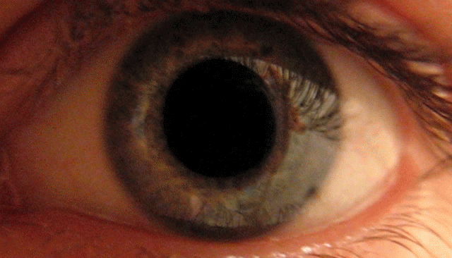
I began to look for these eye anomalies with my other clients and held their gaze at the point of the eye freeze or wobbles
Notes:
I began to look for these eye anomalies with my other clients and held their gaze at the point of the eye freeze or wobble

Slide 15
When I saw any eye reflex I
held my finger in place directly
in front of it so the client could maintain their gaze right
at that spot

Slide 16
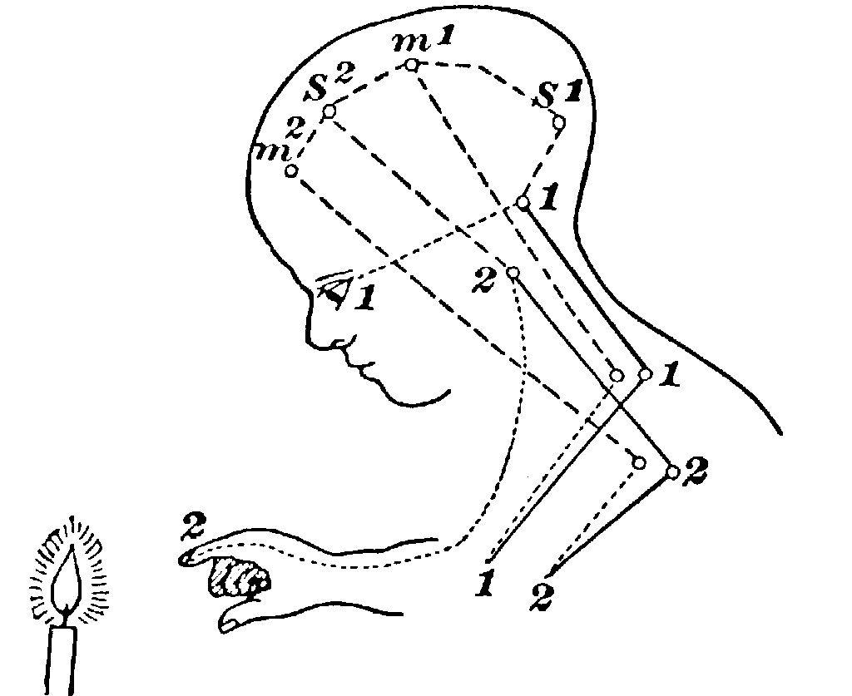
I noticed that any reflexive response in the client revealed the presence of a Brainspot

Slide 17
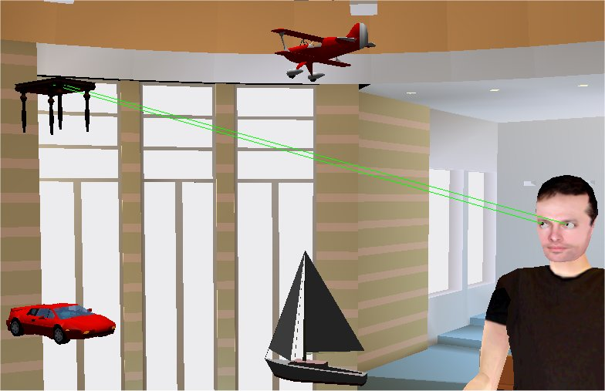
During the following years I discovered many ways of locating relevant eye positions in the field of vision
Notes:
During the following years I discovered many ways of locating relevant eye positions in the field of vision

Slide 18
These include:
Outside Window Brainspotting (BSP)
Inside Window BSP
Gazespotting
Notes:
These include: Outside Window, Inside Window, One Eye, Gazespotting, Z Axis (3 D) Rolling Brainspotting

Slide 19
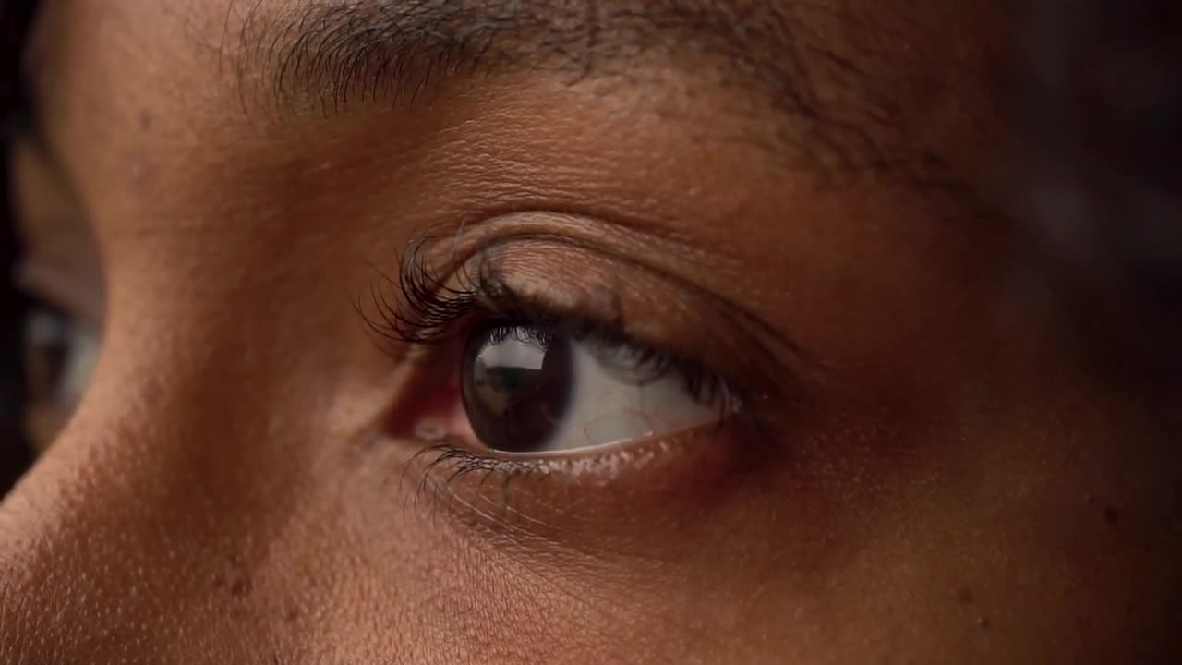
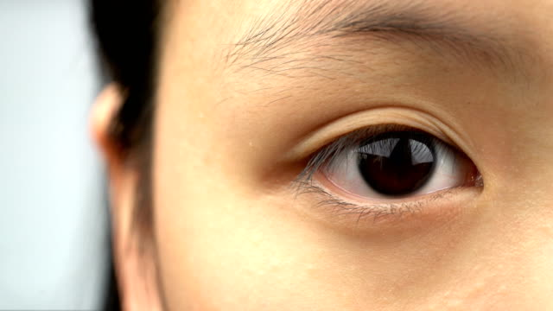
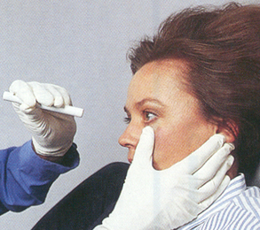
In “Outside Window” Brainspotting the therapist observes the client’s eyes while tracking micro-slowly,
searching for reflexive
responses, without the
client’s awareness or
active participation
Notes:
19

Slide 20
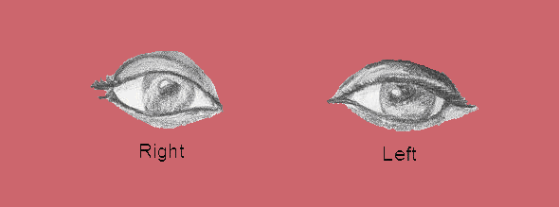
Outside Window
We can observe a multitude of reflexive responses including eye wobbles, freezes, blinks, facial tics, brow furrowing, sniffs, swallows, head nods & body shifting
Notes:
20

Slide 21
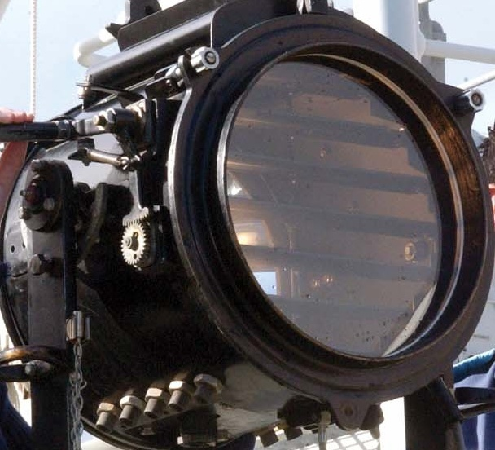
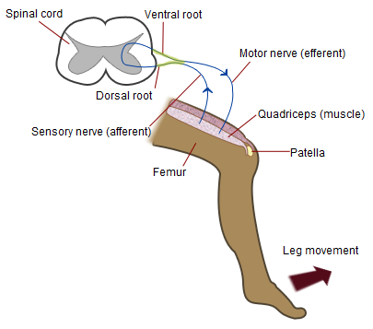
When a Brainspot is activated, the deep brain appears to reflexively signal the therapist, beyond the awareness of the client’s neocortex, that an area of relevance has been located
Notes:
21

Slide 22
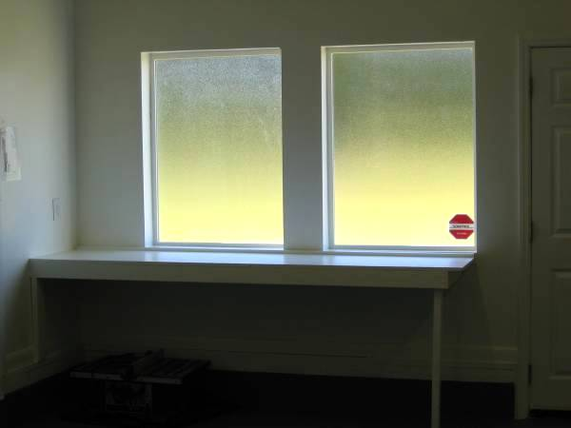
What started as Brainspotting I later called Outside Window as I realized Brainspots can be located & processed from the Inside Window of the client’s felt sense
Outside Window
&
Inside Window
Notes:
22

Slide 23
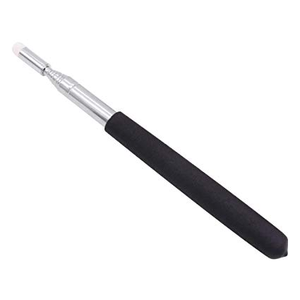
In Inside Window Brainspotting the therapist and client participate together to locate Brainspots through the client’s felt sense of the highest intensity of somatic activation
Notes:
23

Slide 24
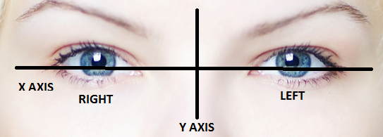
In Inside Window Brainspotting eye positions are divided into two axes, X and Y. First we find the most activated (access) spot horizontally (left, center and right along the X axis) from there we explore vertically (above, at or below eye level on the Y axis)
Notes:
24

Slide 25
Gazespotting
Fixed gazing while thinking or speaking is natural Brainspotting and can be harnessed. This can be observed and used by every therapist.
Notes:
Spontaneous Spot
25

Slide 26
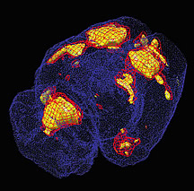
It is hypothesized that a Brainspot is the activity in the subcortical brain in response to focused activation and eye position.
Notes:
A Brainspot is focused activation throughout the brain.
26

Slide 27
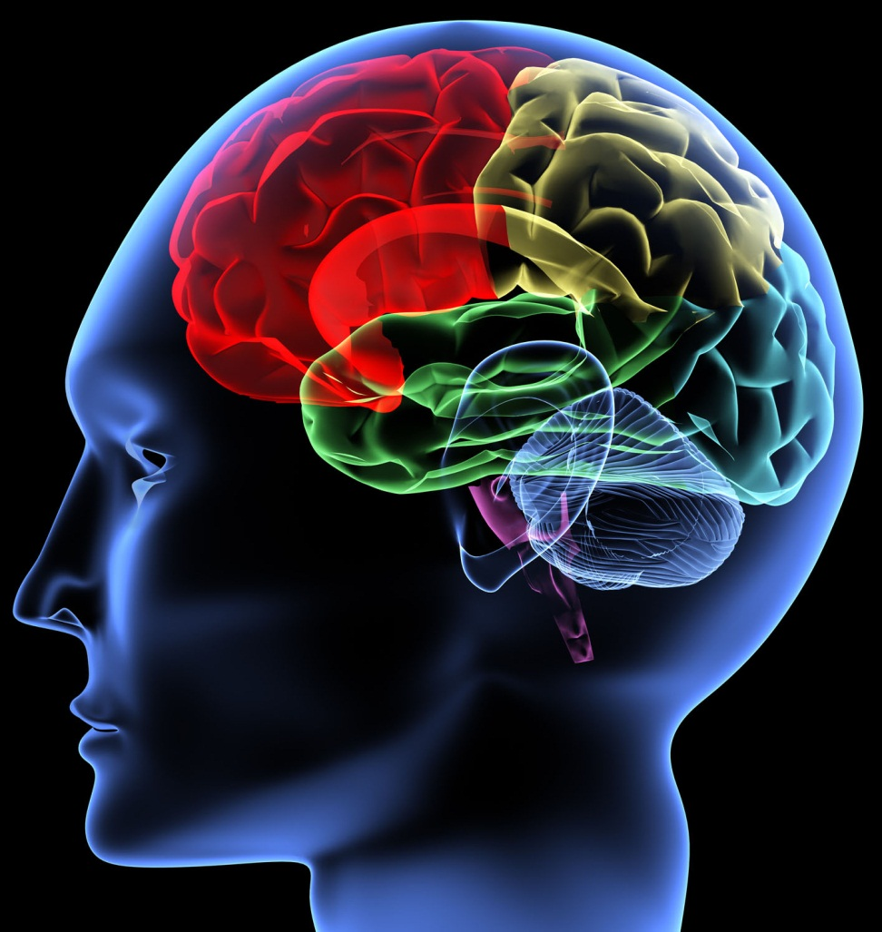
Every brain is a genius, containing one quadrillion (1-4,000,000,000,000,000) synaptic connections (Daniel Amen). This number is essentially infinite and unknowable to the
therapist who sits
in front of the client.

Slide 28
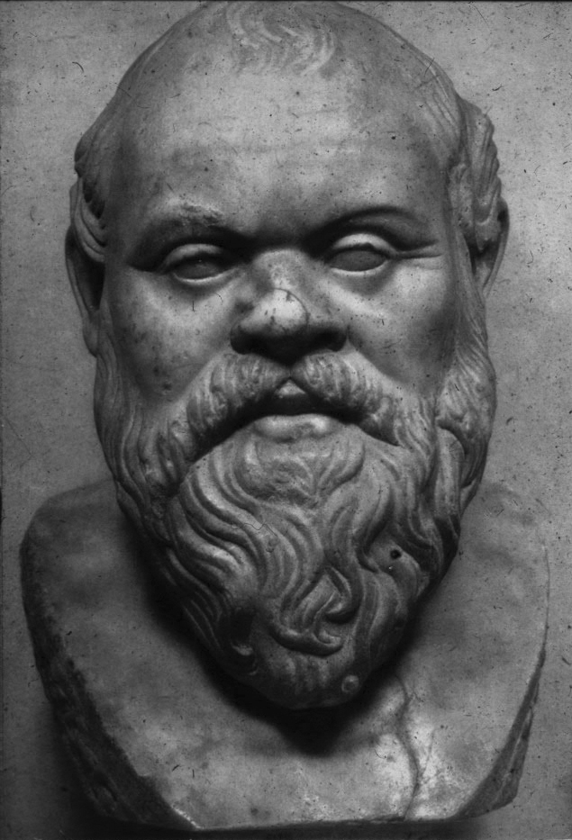
Ἓν οἶδα ὅτι οὐδὲν οἶδα”
“I know one thing -
that I know nothing”
Socrates
The Uncertainty Principle
(Heisenberg)
Notes:
(Literal translation: I saw one thing that I saw nothing.
However, seeing is taken to mean knowing in most translations of this, thus resulting to I know one thing that I know nothing.)
28

Slide 29
In the face of uncertainty, all we have is the frame. The client brings in the frame of their healing needs to the first and all subsequent sessions. The therapist mindfully receives the frame and holds and shapes it with the client.
Notes:
Brainspotting constructs a frame around the client relationally and neurobiologically

Slide 30
Brainspotting constructs
a frame around the client,
relationally and
neurobiologically, which is called the Dual Attunement Frame
Notes:
Brainspotting constructs a frame around the client relationally and neurobiologically

Slide 31
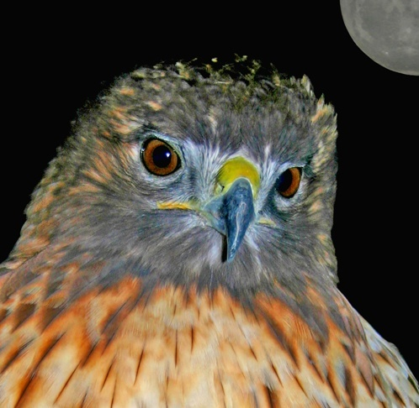
It is the attuned, mindful, witnessing, compassionate presence of the
therapist that engages the client in the relational frame which supports their healing trajectory.
Notes:
Our mindfulness of it enhances the healing

Slide 32
Awareness of body activation leading to locating relevant eye positions (brainspots) comprises the 2nd neurological frame of the Dual Attunement Frame. The neurological frame makes the primary relational frame more focused, deep and accurate in locating unprocessed trauma.

Slide 33
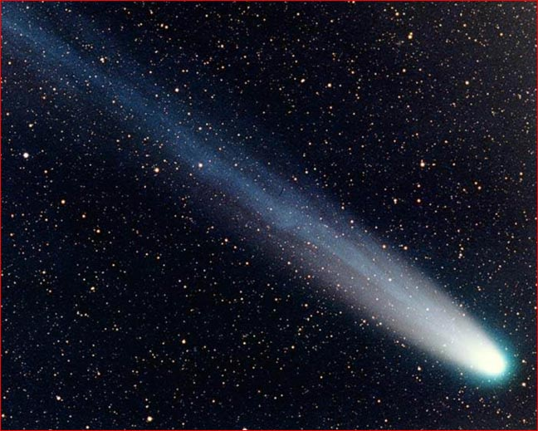
The client is like the head of a comet and the attuned therapist is like the tail of the comet that follows the head wherever it goes.
Notes:
The client is like the head of a comet and the attuned therapist is like the tail.

Slide 34
Intervention is to be used as minimally and temporarily as possible
as the goal of Brainspotting
is accessing and focusing
client’s self-healing
capacities
Notes:
Technique is to be used as minimally and temporarily as possible as the goal of BSP is accessing self-healing capacities.

Slide 35
BSP is an open, creative, integrative model. It is designed to be adapted into any clinical approach and therapeutic style
Brainspotting recognizes and honors other healing modalities.
Notes:
BSP is designed to be integrated into any clinical approach and therapeutic style

Slide 36
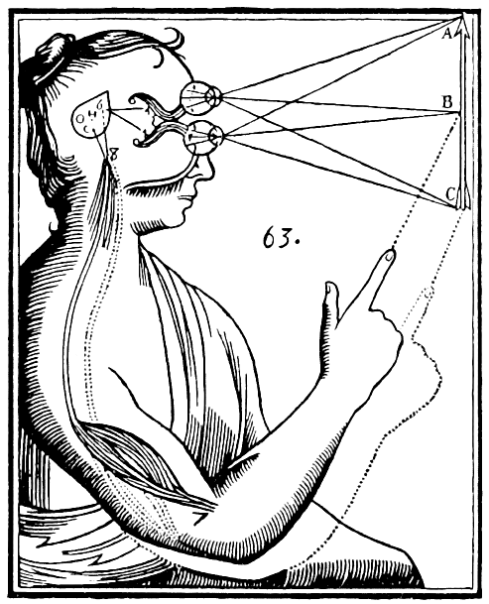
BSP appears to access the right brain, the limbic system and the brainstem (midbrain)
BSP is accordingly seen
as a physiological
approach with
psychological consequences.
This is the foundation of
the Neuroexperiential model
Notes:
BSP works with the deep brain and the body through it’s direct access to the autonomic and limbic systems. BSP is accordingly a physiological approach with psychological consequences.
36

Slide 37
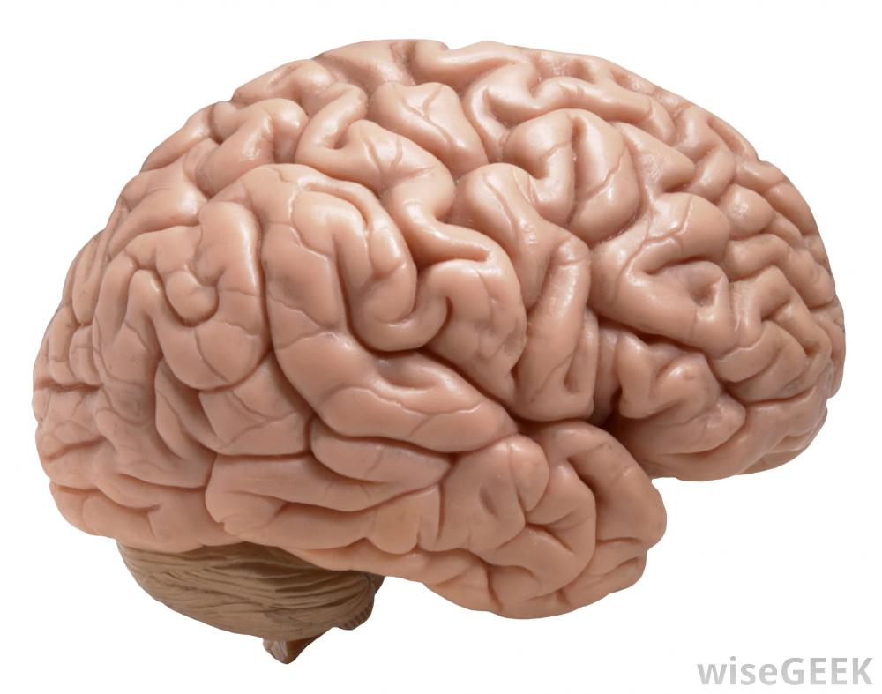
Brainspotting is a relational, brain-body, mindfulness
based therapy
Notes:
Brainspotting is a “brain-based” therapy

Slide 38
The goal of every psychotherapy is to move clients from dysregulation to regulation.
Brainspotting aims to engage the regions of the brain that are specifically involved in neurobiological regulation and bypass the regions that are not involved in it.

Slide 39
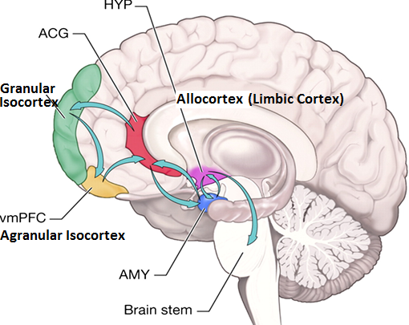
The agranular isocortex (ventromedial, orbitofrontal and anterior pfc) and the allocortex are involved in ongoing regulation, the granular isocortex (neocortex) is not.

Slide 40
The granular isocortex has 6 layers and the 4th is granular. This contributes to higher order processing but not to regulation
The agranular isocortex has 3 to 5 layers with no granular layer. It accordingly is highly involved in regulation

Slide 41
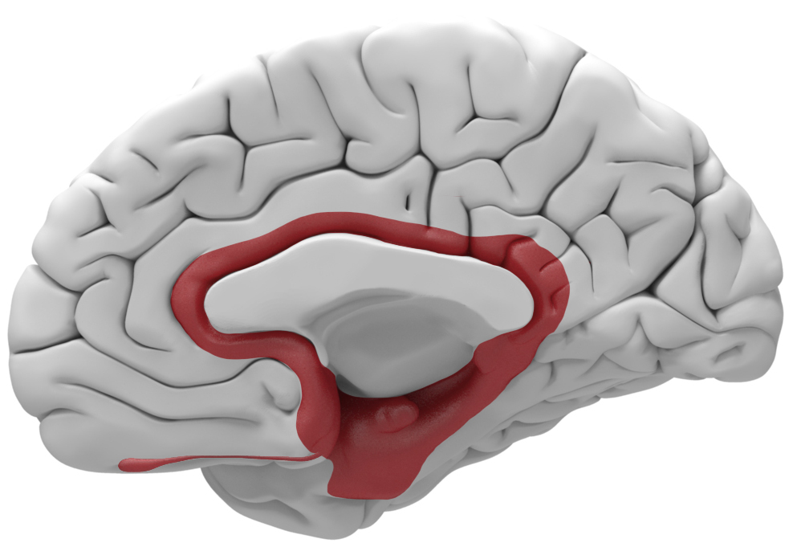
The limbic system has a cortex known as the allocortex (limbic cortex) which is highly involved in regulation

Slide 42
Brainspotting attempts to bypass the granular isocortex in order to access the regulating capacities of the agranular isocortex and the allocortex

Slide 43
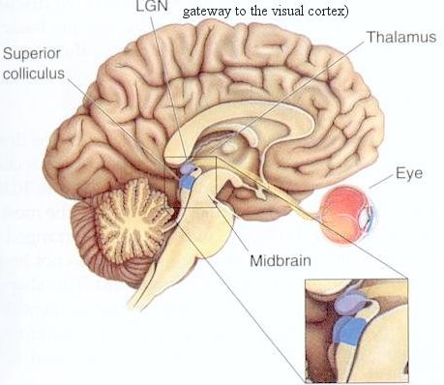
Back to Image Results
Remove FrameRemove Frame
It is theorized the BSP accesses the
visual (1st) and tactile (3rd) layers
of the Superior Colliculi.
Notes:
It is theorized the BSP accesses the visual (1st layer) and tactile (3rd layer) of the Superior Colliculi

Slide 44
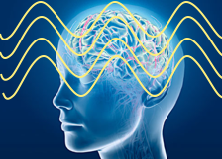
Brainspotting appears to promote coherence between the sympathetic and parasympathetic activation
Notes:
Brainspotting promotes coherence between the sympathetic and parasympathetic activation

Slide 45
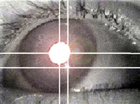
The Brainspotting Set-Up
1. The beginning - choose the issue
2. Check on activation
3. SUDS Level (10 to 0)
4. Location of activation in the body
5. Locate eye position of greatest observed or perceived activity – Outside or Inside Window
6. Focused Mindfulness (Processing)
7. Go back to the beginning to assess change
8. Squeeze the lemon
Notes:
45

Slide 46
The beginning -
choosing the issue

Slide 47
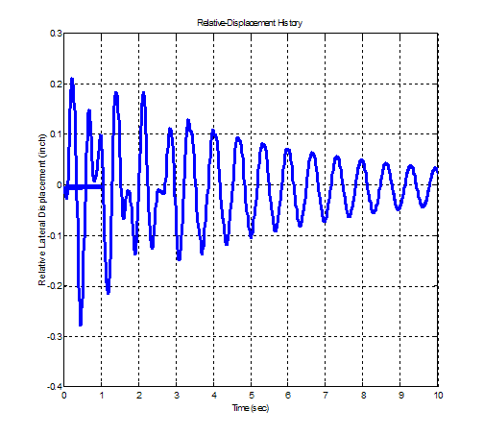
Activation
Brainspotting works with felt sense and activation is used as an open, inclusive term

Slide 48
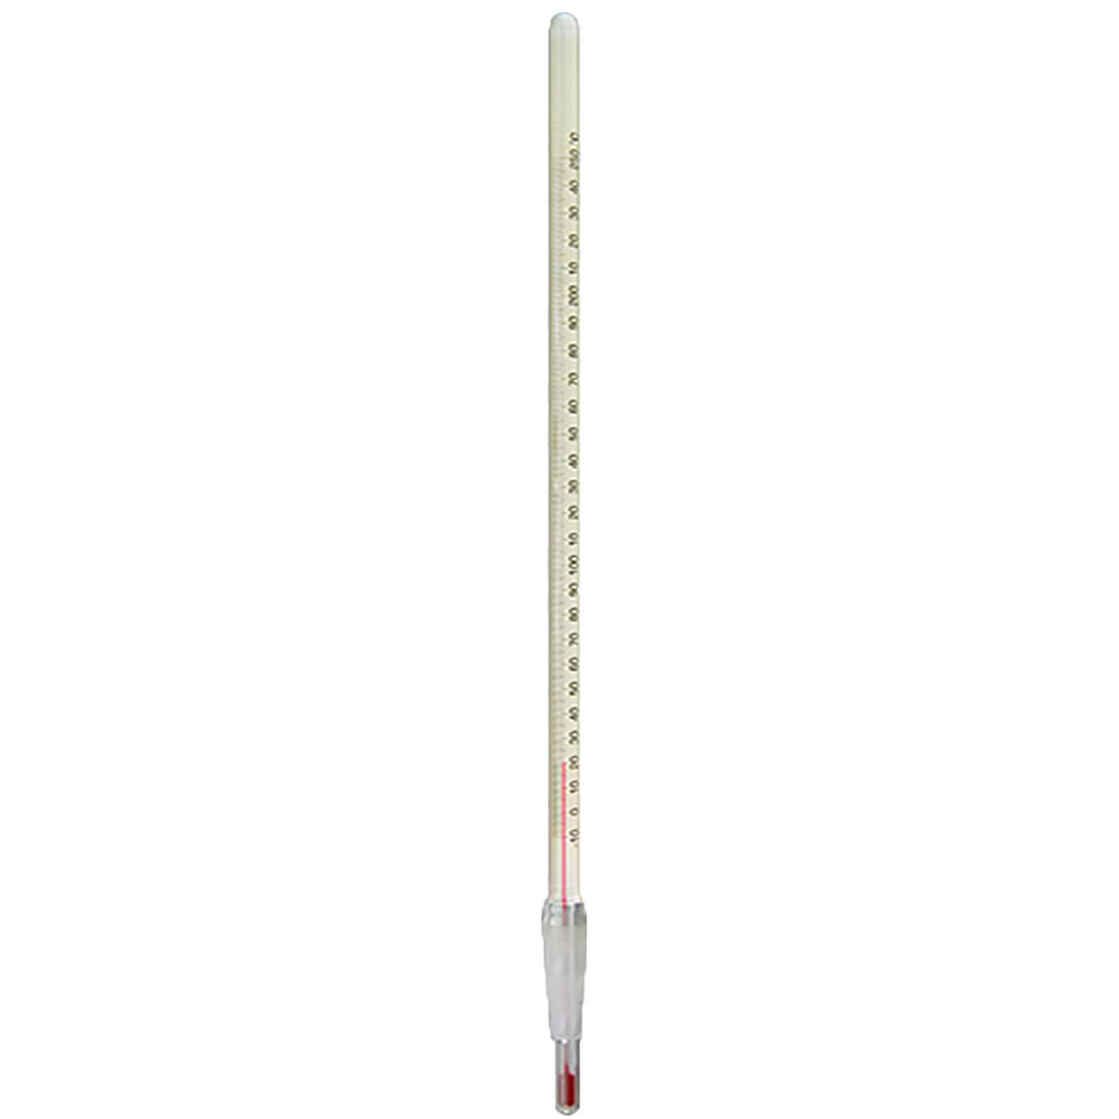
SUDS Level (10 to 0)
Developed by Joseph Wolpe
Accesses the numerical capacities of the brain to assess level of activation. There is no inherent value to it, like a thermometer. It is a subjective assessment different from person to person. It is important to be mindful that the SUDs can go up in the service of healing as dissociative barriers are approached. The SUDs is
accurate in assessing hypoarousal
but less so with hypoarousal.

Slide 49
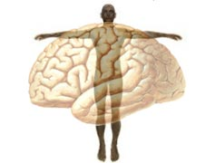
Location of activation in the body
Increases the focus and accesses the simultaneous brain-body communication

Slide 50
“What’s in the brain is in the body and what’s in the body is in the brain”

Slide 51
Locate eye position of greatest observed or perceived reflexive
or orienting activity
Outside or Inside Window

Slide 52
Focused Mindfulness (Processing)
Observing one’s ongoing internal process while in a state of focused activation
(the head of the comet)
Notes:
Observing one’s internal process while in a state of focused activation

Slide 53
Go back to the beginning to assess change

Slide 54
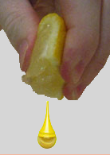
“Squeezing the lemon” is a technique for making sure that all remaining remnants of activation are processed out. When a client is at a zero SUDS guide them to “go inside and try to push the activation level as high as you can”
Repeat the process until
no activation can be elicited
Notes:
54

Slide 55
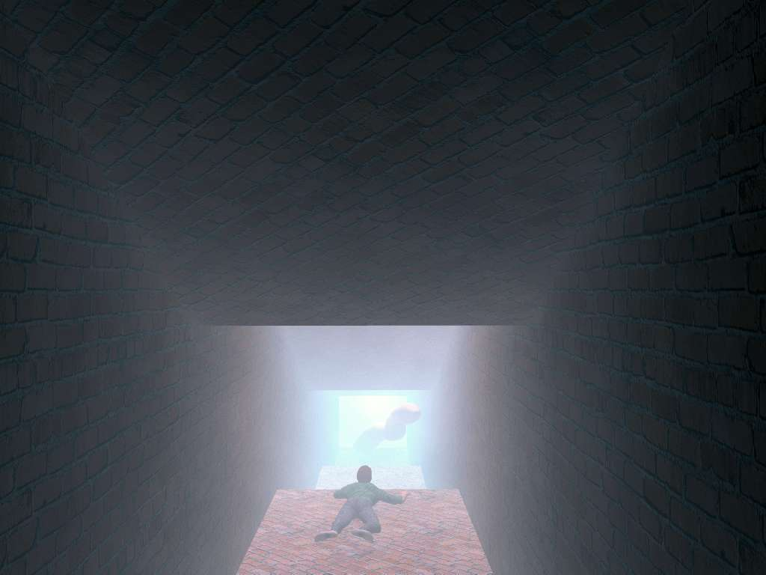
The Neuroexperiential Model of Brainspotting
Notes:
55

Slide 56
The Neuroexperiential Model (NEM) aims to develop language and concepts that attune to the experiences with clients of the attuned, present, process-oriented therapist.
Notes:
The Neuroexperiential Model (NEM)

Slide 57
The population of Europe and North America combined is 1 billion
The population of the rest of the world is 7 billion
The evidence-based and diagnostic models have been developed, applied and seen through the Western lens. Relationship, community and culture tend to not be seen or studied in these models
The NEM attempts to see the human experience through a global lens including Western, Eastern and Indigenous healing wisdom and practices
Notes:
Europe and North America have a combined population of 1 billion

Slide 58
Brainspotting is a NEM as it mindfully engages the subcortex and the implicit as opposed to the neocortex and the explicit. Accordingly, the neocortex needs the raw subcortical sensory and affective information it receives in order to perform its higher order functions.
Notes:
Observing one’s internal process while in a state of focused activation

Slide 59
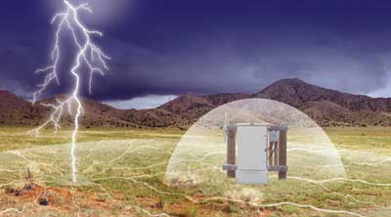
The Western approach utilizes explicit, neocortical (language and thinking-based) history-taking. The NEM recognizes that most early developmental history is implicit and inaccessible to verbal, cognitive history-taking at the beginning of treatment.
History-taking leads to assignment of diagnosis which is coded, symptom cluster-based and labeled as disorders. The NEM is a developmental model that views human suffering a resulting from developmental traumas that lead to survival dissociation. The NEM developmental model looks at generational, intrauterine, birth and early attachment experience as foundational to what clients bring to therapy. As such, symptoms are seen as primitive survival mechanisms, not pathological or disordered.
Notes:
Observing one’s internal process while in a state of focused activation

Slide 60
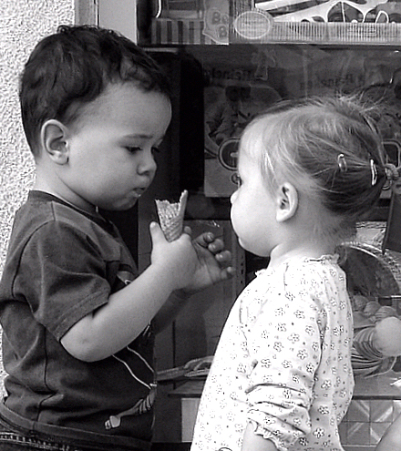
The Western approach utilizes diagnosis to form a treatment plan with delineated treatment goals. Brainspotting as a NEM receives and holds the client’s frame in the context of uncertainty and follows the client’s process wherever it goes.
The Western treatment plan informs the therapist’s interventions. The NEM mindfully follows the client’s processing only intervening when necessary, believing that the mutually held frame accesses and promotes the client’s innate capacity for regulation and healing.
Notes:
Observing one’s internal process while in a state of focused activation

Slide 61
Repeated developmental traumas leads to compliance (fawn response) as a natural mode of survival. This compliance leads to a loss of choice, control and the capacity to trust. The Western history-taking, diagnosis, treatment planning and goal setting, intervention model may be based on certainty and can risk evincing the programmed compliance response.
Brainspotting as a NEM relies primarily on Uncertainty, framing and following, which can help a client to feel choice, control and the possibility of trust, thus supporting coming out of the survival compliance.
Notes:
Observing one’s internal process while in a state of focused activation

Slide 62
So what does the Neuroexperiential Model (NEM) posit? It is a deeply bottom-up model that believes humans are developmental beings with internal processes that arise from the deepest places within us. This encompasses the various networks of nervous systems in us (autonomic, peripheral, enteric, cardiac) as well as those yet to be discovered.
The NEM also includes meridians, chakras, the core self and the soul. The NEM posits that most inner experiences that rise up never come close to consciousness. What does arise into conscious awareness is seen as the sensory, the gateway between the deep and the conscious. Out of the sensory flows the intuitive and the affective. The final stop on this experiential sweep is the thinking, planning, language neocortex.
Notes:
Observing one’s internal process while in a state of focused activation

Slide 63
Trauma is seen as leading to systemic contraction and trauma healing is seen as facilitating systemic expansion. Flight, fight and freeze are seen as underpinning most symptom clusters. The unprocessed flight response is seen as manifesting as anxiety, panic and agitation. The unprocessed fight response is seen as manifesting as anger and rage. The freeze response is seen as manifesting as depression, hypoarousal and dissociation. These states are also seen as emotional/somatic flashbacks (especially parts in flashback).
Our senses are seen as central to our experience and the NEM. Sensory gating is a mechanism that allows humans to filter out sensory experience that would overwhelm or flood the system’s capacity for regulation and information processing. Sensory gating is accordingly seen as the underlying mechanism of survival dissociation. Successful trauma healing is believed to help the system trust that the threat is in the over, in the past and unlikely to reoccur.

Slide 64
Recommended Readings
Eben Alexander, Living In A Mindful Universe, 2017
Gabor Mate, the Myth of Normal, 2022
Xavier Noel, Antoine Bechara, Bridging the Gap between the Lab and the Clinic: Psychopatholgy’s Grand Challenge, Frontiers in Psychology, Nov 2016
Robert Scaer, The Trauma Spectrum, 2005
Jeffrey R. Stevens, Replicability and Reproducibilty in Comparative Psychology, Frontiers in Psychology, May 2017
Stephen Sideroff, Why Preserve the Wisdom of Indigenous People, Psychology Today, May 2018
D.A. Wilson, Sensory Gating, The Senses: A Comprehensive Reference, 2008
Darya Zabelina, Creativity and Sensory Gating, Psychology Today, Jan 2015
Notes:
Sensory Gating

